Slide 1
LAUNCH Project Toolkits Campus Food Rescue

Slide 2
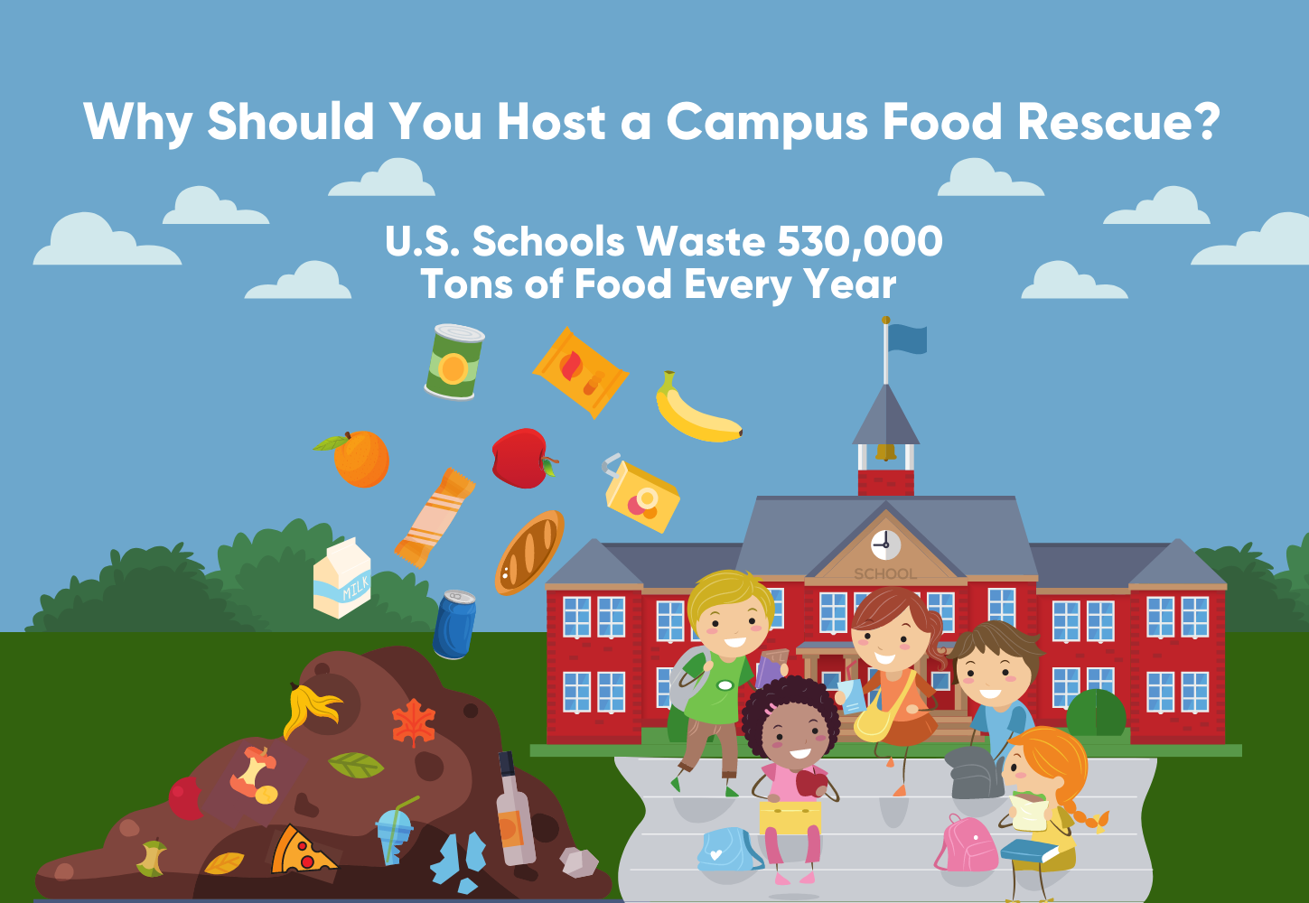
LAUNCH Project Toolkits
GRADESOFGREEN.ORG
A lot of perfectly good food is wasted across the world everyday for many different reasons.
On school campuses, food waste usually happens because students don’t like the food that is served, given more food than they can eat, or don’t have enough time to eat their entire meal.
This results in a lot of food being thrown in the trash, which ends up in landfills.
Reports estimate that U.S. schools waste 530,000 tons of food per year, which costs as much as $9.7 million a day to manage (World Wildlife).

Slide 3
LAUNCH Project Toolkits
GRADESOFGREEN.ORG
Food waste in landfills is a big contributor to climate change. When food breaks down in a landfill, it gives off methane, a powerful greenhouse gas.
According to the Environmental Protection Agency, food is the single largest category of material placed in United States landfills, which is also the third-largest source of human-related methane emissions in the country (USDA).

Slide 4
LAUNCH Project Toolkits
GRADESOFGREEN.ORG
Safe and wholesome food that is currently wasted could help feed families in need.
Much of the food that is currently thrown away can help feed hungry individuals and reduce food insecurity.
Each year, food banks like Feeding America rescue and redistribute around 3.6 billion pounds of food. This is only a small percentage of food that could have been donated instead of going to a landfill (USDA).

