Slide 1
LAUNCH Project Toolkits Energy Audit

Slide 2
LAUNCH Project Toolkits
GRADESOFGREEN.ORG
Much of Our Energy Comes from Fossil Fuels
Although many countries are investing more and more into renewable energy sources, such as solar and wind, much of the energy that we use throughout the world still comes from fossil fuels. Coal, crude oil, and natural gas are all considered fossil fuels because they were formed from the fossilized, buried remains of plants and animals that lived millions of years ago. Because of their origins, fossil fuels have a high carbon content. Today, oil, coal, and gas provide roughly 80% of our energy needs. Extracting and burning fossil fuels releases chemicals and greenhouse gasses into the atmosphere, which causes air pollution and increased global temperatures.

Slide 3
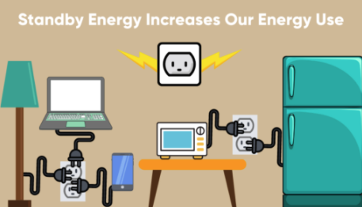
LAUNCH Project Toolkits
GRADESOFGREEN.ORG
Standby Energy
Many appliances leech energy even when they are shut off; this is called standby energy and can account for 20% of a household’s energy bill every month. Every cord that remains plugged into an outlet is pulling energy out. While many of them have “standby mode,” they still continuously use electricity to perform updates, connect to remotes, and record data. Some of the most common appliances that “leak” energy are computers, printers, satellite and cable boxes, stereos, TVs, microwaves, garage door openers, and video game consoles.

Slide 4
LAUNCH Project Toolkits
GRADESOFGREEN.ORG
Simple Habits Can Reduce Energy Consumption
It’s easy to save energy and thereby reduce pollution from fossil fuels. Some notable changes include:
Unplugging appliances that are not in use
Using power strips that can be turned off at night
Replacing incandescent light bulbs with LED light bulbs
Install motion activated light switches

