Slide 1
LAUNCH Project Toolkits Transportation Thursday

Slide 2
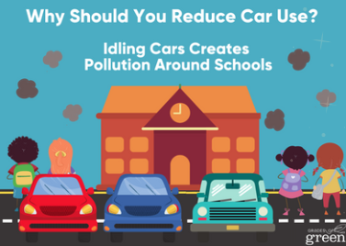
LAUNCH Project Toolkits
GRADESOFGREEN.ORG
Idling Cars Creates Pollution Around Schools
Studies at school’s have shown that many parents tend to idle their vehicles when waiting to pick up their students and there are elevated levels of air toxics during these afternoon pickup times. While children’s lungs are especially susceptible to air pollution, limiting idling can dramatically reduce these pollutants and children’s exposure to them.

Slide 3
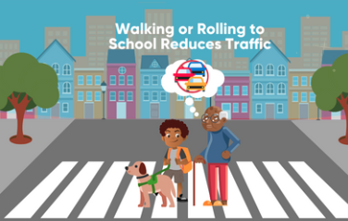
LAUNCH Project Toolkits
GRADESOFGREEN.ORG
Walking or Rolling Reduces Traffic
On top of the personal benefits of walking/biking to school, taking this action also helps the people around you. Roughly 10-14% of cars in the morning are students/student’s parents making their way to campus. In the United States alone, that is roughly 14 million cars everyday!

Slide 4
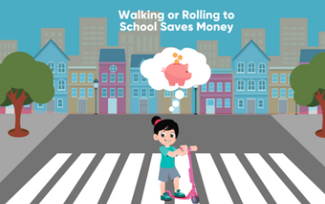
LAUNCH Project Toolkits
GRADESOFGREEN.ORG
Walking or Rolling Saves Money
We’ve learned a lot about the people who can benefit from students walking/rolling to school, but it is important to address how it can help families. Parents can save money by reducing their gasoline consumption while lowering carbon emissions that contribute to climate change. Furthermore, reducing the amount of cars on the road can decrease the amount of money spent on maintaining streets, while school districts can decrease the cost of bus systems. Some schools have even saved up to $237,000 as a result of students walking/biking to school.

