Slide 1
LAUNCH Project Toolkits Green Fashion Friday

Slide 2
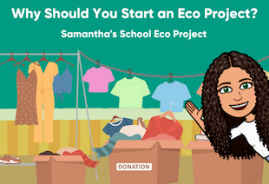
LAUNCH Project Toolkits
GRADESOFGREEN.ORG
Samantha’s School Eco Project
Starting in 2nd grade, Samantha Torres was inspired to become an Eco-Leader who developed her personal ideas into environmental projects. Most recently, she wanted to tackle the issue of clothing waste in her local community. She came up with the idea of doing a clothing swap where students from her high school could swap out clothes that no longer fit them, they no longer enjoyed wearing, or no longer needed. This allowed clothes to be reused, giving them a new purpose instead of going to a landfill as waste. As a college student, Samantha continues her Climate Activism as an advocate for going meatless and alleviating clothing waste/fast fashion.

Slide 3
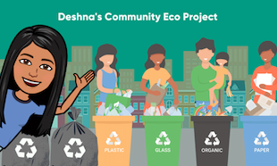
LAUNCH Project Toolkits
GRADESOFGREEN.ORG
Deshna’s Community Eco Project
Deshna Jain is a sixteen-year-old from Kolkata, India. Along with being a full-time student in class XII (high school), she spends her time advocating for action on climate change through her organization, ‘To Environment, With Love’ which she founded in 2019 with the aim to bring together teens from across the world who believe in the urgency of combating the environmental crisis. Deshna started her Eco Project by knocking on people’s doors in her community to collect recyclables and items to donate. Today, their body of 27 students from 6 countries have collectively recycled over 100,000 kgs of waste and they don’t plan to stop till people make recycling a daily practice.

Slide 4
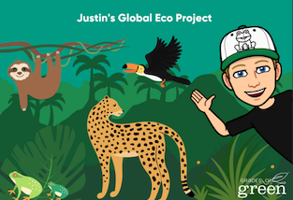
LAUNCH Project Toolkits
GRADESOFGREEN.ORG
Justin’s Global Eco Project
There are many ways to be an activist and inspire others toward environmental action. One person who has made a difference is Grades of Green Eco-Leader, Justin Sather. He has given many presentations to schools about how his love for frogs inspired him to take care of the planet. One way Justin decided to take action was to collect hundreds of letters from students around the world explaining why they love nature and why they want to protect it. These letters were given to world leaders at the COP26 Conference to convince them to take stronger actions on protecting 30% of the planet by 2030. Justin also set up a Go Fund Me Campaign and raised money to protect 30 acres of rainforest in Ecuador. You too can inspire those around you with your actions and commitment by turning your own ideas into a reality.

