Slide 1

LAUNCH Project Toolkits
Adopt a Spot

Slide 2
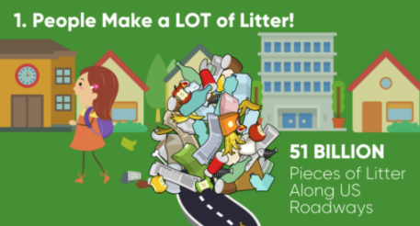

LAUNCH Project Toolkits
GRADESOFGREEN.ORG
People Make A LOT of Litter!
You might only see a few pieces of litter on your street, but researchers found that on average there are more than 13 thousand pieces of litter per mile of American roadway. All together, it’s estimated there are 51 billion pieces of litter on all US roads at any moment. If you add in ocean litter, there are more pieces of plastic in the seas than there are stars in the galaxy.

Slide 3
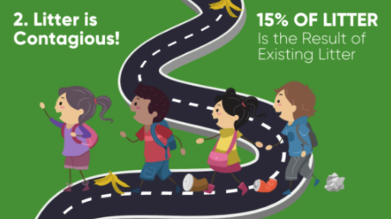
LAUNCH Project Toolkits
GRADESOFGREEN.ORG
Litter Travels!
A plastic wrapper dropped in the parking lot doesn’t stay there for long. It gets blown to the curb, washed through storm drains into rivers, and out to sea. Scientists estimate that almost 9 million tons of plastic litter end up in the ocean—every year. This is the equivalent of five grocery bags filled with plastic trash sitting on every foot of coastline around the world.

Slide 4
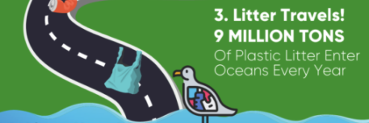
LAUNCH Project Toolkits
GRADESOFGREEN.ORG
Litter Hurts!
Litter affects animal and human health. It’s estimated that over 1 million land animals and 100 million sea animals die each year after eating or becoming trapped in litter. Litter also releases chemicals and microparticles as it breaks down in the environment. These toxic particles end up in the air that we breathe, the soil where we grow food and in the water we drink.

Slide 5
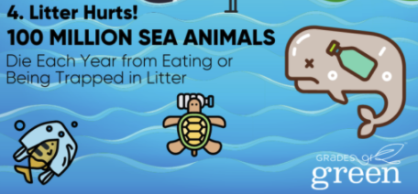
LAUNCH Project Toolkits
GRADESOFGREEN.ORG
Litter is Contagious!
When people see litter or others littering, they are more likely to litter themselves. In fact, research shows that about 15% of littering activities are motivated by existing litter in an environment.

