Slide 1

LAUNCH Project Toolkits
Classroom Recycling Toolkit

Slide 2
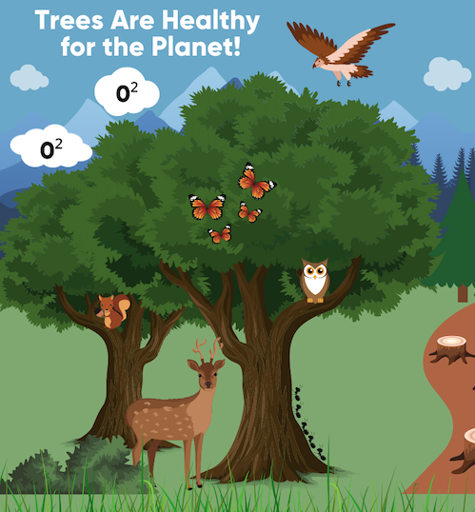

LAUNCH Project Toolkits
GRADESOFGREEN.ORG
Trees Are Healthy For the Planet!
Trees provide many benefits to the health of both people and the planet. They provide shade, cool neighborhoods, they create habitats for birds/wildlife, and prevent soil erosion. As trees grow, they help slow down climate change by removing carbon dioxide from the air, storing carbon, and releasing oxygen into the atmosphere.

Slide 3
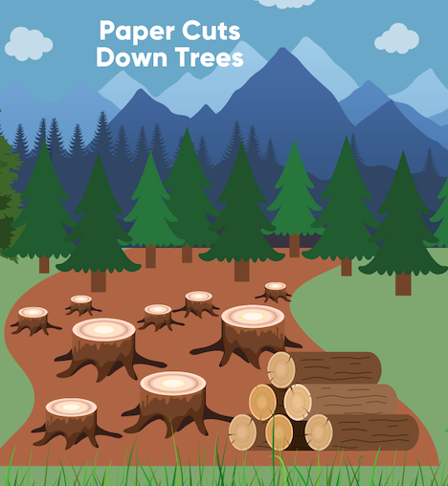
LAUNCH Project Toolkits
GRADESOFGREEN.ORG
Paper Cuts Down Trees
Papermaking has an impact on the environment because it destroys trees in the process. According to data from the Global Forest Resource Assessment, roughly 80,000 to 160,000 trees are cut down each day around the world with a large portion of that being used to make paper. This contributes to global deforestation which in turn is a big cause of global warming and climate change.

Slide 4
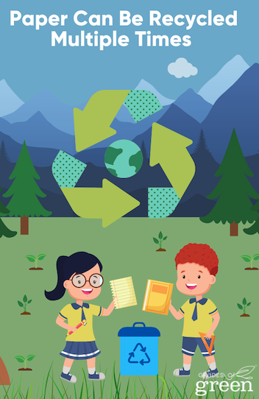
LAUNCH Project Toolkits
GRADESOFGREEN.ORG
Paper can be recycled multiple times!
Recycling paper is very important in reducing the environmental impact of paper manufacturing. Paper can be recycled about 5 to 7 times before the fibers become too short to be reused and using one ton of recycled paper can prevent 17 trees from being cut down.

