Slide 1

LAUNCH Project Toolkits
Composting at School

Slide 2
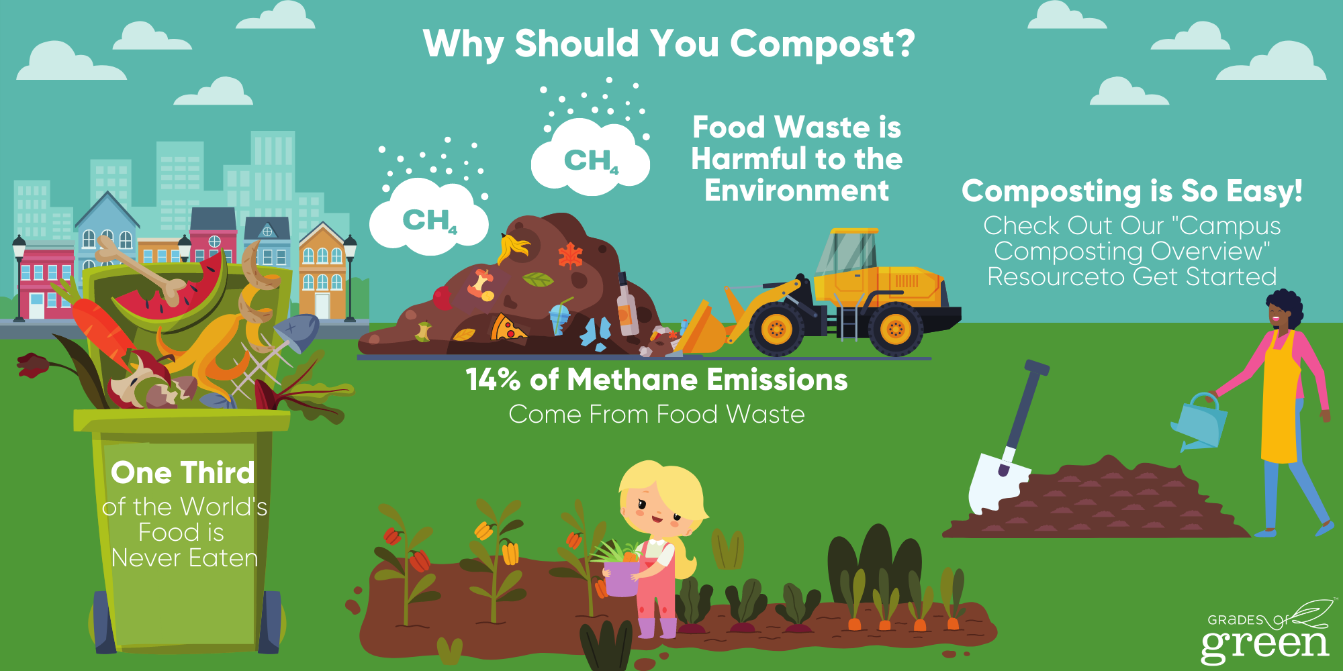

LAUNCH Project Toolkits
GRADESOFGREEN.ORG
Billions of Pounds of the Food We Produce is Wasted
Did you know more than 60 billion pounds of mineral-rich food go to landfills each year in the U.S. alone (Eco-Watch) while US schools waste 530,000 tons of food annually (World Wildlife Fund).
That’s right, sadly, about 70% of the waste that we throw away without a second thought could be repurposed to create a nutrient rich product that supports healthy soil and can grow nutritious food without using chemical fertilizers (Earth Guardians).

Slide 3
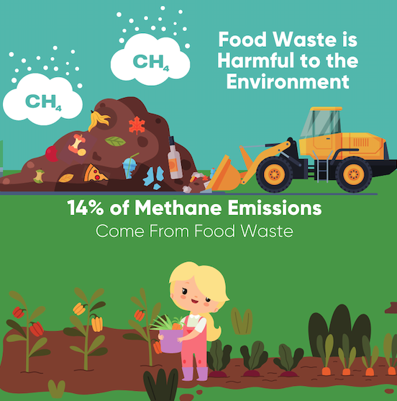
LAUNCH Project Toolkits
GRADESOFGREEN.ORG
Wasted Food is Harmful to the Environment
When food waste rots in a landfill it releases harmful greenhouse gasses that trap the sun’s heat in our atmosphere and contribute to global warming.
According to the US Environmental Protection Agency, food is the single largest category of waste put in landfills. Food in landfills emits methane, a powerful greenhouse gas.
Landfills are the third-largest source of human-related methane emissions in the United States (USDA).
However, when food is composted, it releases no greenhouse gasses at all, effectively reducing emissions mentioned above.

Slide 4
LAUNCH Project Toolkits
GRADESOFGREEN.ORG
Composting Is So Easy!
Composting is nature’s way of recycling. It happens every second of every day when dead plants and animals decompose and break down into soil in natural environments.
When food waste is combined with carbon rich materials like dried leaves, sawdust, shredded paper, moisture and heat from the sun, it will quickly break down and transform into humus, also known as compost.
This can be done in a backyard compost bin, a community garden or sometimes through your municipal waste hauler. When added to gardens and landscaping, finished compost will help rebuild the soil nutrients and hold in moisture.
Best of all – it’s the best soil to help you grow nutritious food!

