Slide 1

LAUNCH Project Toolkits
E-Waste TOOLKIT

Slide 2
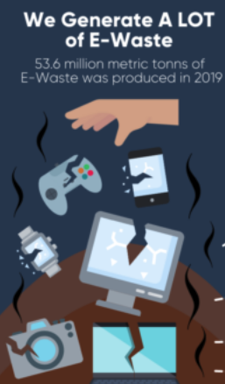

LAUNCH Project Toolkits
GRADESOFGREEN.ORG
In addition to the environmental impacts that E-Waste has through its chemical components, there is a significant amount of it generated. In fact, 53.6 million metric tonnes of E-Waste was produced in 2019 alone. That equates to the weight of 11.8 million elephants.

Slide 3
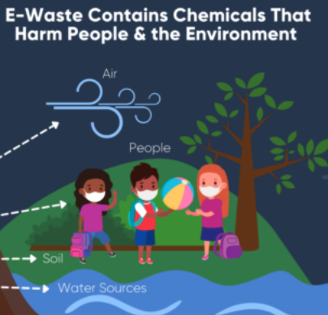
LAUNCH Project Toolkits
GRADESOFGREEN.ORG
While normal waste has a major impact on the environment, E-Waste harms ecosystems due to its chemical composition. E-waste is a health and environmental hazard, containing toxic additives or hazardous substances such as mercury, which damages the human brain and/or coordination system.

Slide 4
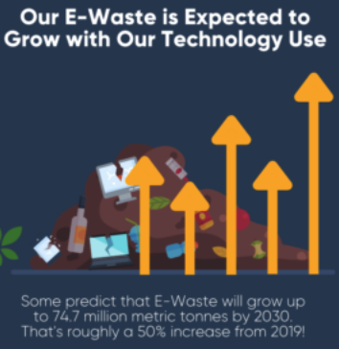
LAUNCH Project Toolkits
GRADESOFGREEN.ORG
With the rapid growth of technology use across the world, the magnitude of E-Waste is likely to grow. Some predict that E-Waste is projected to grow up to 74.7 million metric tonnes by 2030. That is roughly a 50% increase from 2019 statistics.

