Slide 1

LAUNCH Project Toolkits
Energy Audit

Slide 2
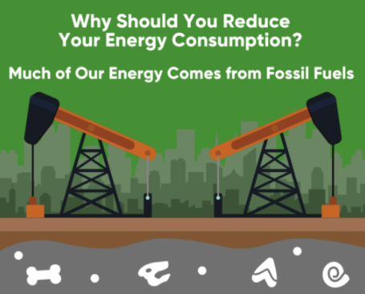

LAUNCH Project Toolkits
GRADESOFGREEN.ORG
Our Energy Comes from Fossil Fuels
Today, energy sources such as oil, coal, and gas make up 80% of our energy resource consumption. They are referred to as “fossil fuels,” and their extraction often releases chemicals and greenhouse gasses into the atmosphere. This causes air pollution and increases global temperatures, which contributes to global warming.

Slide 3
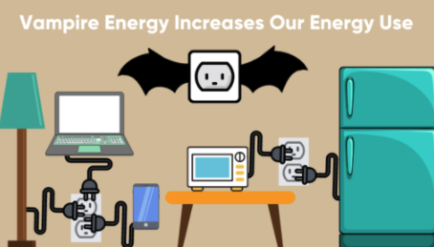
LAUNCH Project Toolkits
GRADESOFGREEN.ORG
Vampire Energy
When an appliance is plugged in, it still uses energy, even if it’s not turned on. This kind of secret energy sucking is called vampire energy. Studies have found that vampire energy accounts for 5-10% of the total electricity in residential homes and accounts for about 1% of the world’s carbon dioxide emissions. Appliances can range from anything to a lamp, fridge, or an electric pencil sharpener. Some of these appliances have to be plugged in and turned on at all times, but there are still others that do not have this requirement.

Slide 4
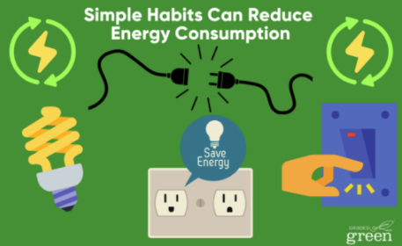
LAUNCH Project Toolkits
GRADESOFGREEN.ORG
Simple Habits Can Reduce Energy Consumption
It’s easy to save energy and thereby reduce pollution from fossil fuels. Some notable changes include:
Unplugging appliances that are not in use
Using power strips that can be turned off at night
Replacing incandescent light bulbs with LED light bulbs
Install motion activated light switches

