Slide 1

LAUNCH Project Toolkits
Flush Smart

Slide 2
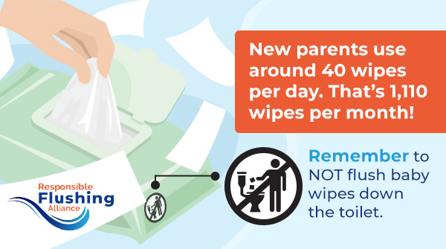

LAUNCH Project Toolkits
GRADESOFGREEN.ORG
To Flush or Not to Flush?
According to the Responsible Flushing Alliance, most wipes, 93% in fact, are not meant for flushing down the toilet. These wipes are called non-flushable wipes. They can cause harm to sewer systems and infrastructure because they are made with long, often plastic fibers and are not meant to dissolve in water. That's why it is important to look at the package and if you see the "Do Not Flush" symbol, toss that wipe in the trash and never the toilet. Non-flushable wipes include all baby wipes, cleaning wipes, disinfecting wipes, and makeup removal wipes, just to name a few. Wipes that are specifically called flushable (about 7% of all wipes) are made of short, natural plant-based fibers and are made to dissolve in water like toilet paper. But, if you are unsure of what to do, it is always better to toss a wipe in the trash rather than the toilet.

Slide 3
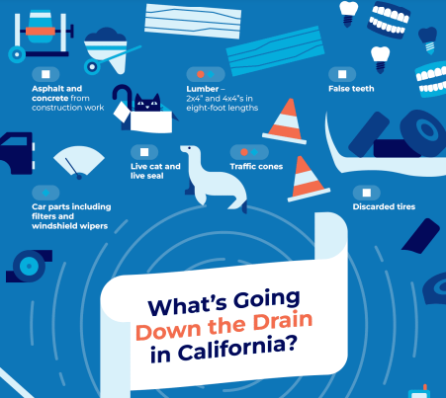
LAUNCH Project Toolkits
GRADESOFGREEN.ORG
Know Before You Go
The Clean Water Act of 1972 just turned 50 years old, yet over 50% of the lakes and rivers in the United States are labeled "impaired". This means that the water is too polluted for us to swim, drink, or participate in any other fun activity with these water sources.(1) According to the Environmental Protection Agency, 850 billion gallons of raw sewage is dumped into waterways across America every year. This is about the same amount of water the Mississippi River carries into the Gulf of Mexico annually.

Slide 4
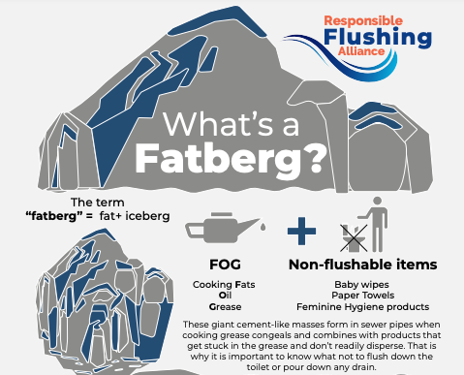
LAUNCH Project Toolkits
GRADESOFGREEN.ORG
Think Before you Flush (or drain!)
The National Association of Clean Water Agencies (NACWA), states that it costs over $400 million dollars to fix and clean up wastewater treatment equipment when we flush non-flushable wipes in the toilet. If our sewage systems get clogged or leak, it can pollute our groundwater and even flow back into our homes affecting the safety of our community. When we flush smart, we save our water, time, health, and money. (1)

