Slide 1

LAUNCH Project Toolkits
Green Team Toolkit

Slide 2
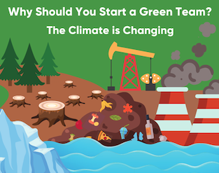

LAUNCH Project Toolkits
GRADESOFGREEN.ORG
The Climate is Changing!
Due to human activity, global temperatures have risen 1 degree celsius in the last century. Our actions have led to melting polar ice caps, world-wide habitat destruction, and rising sea levels. If humankind does nothing to alleviate our negative impacts on the planet, these issues could become irreversible. That’s why it's up to us to take action and fight climate change now, before it becomes too late.

Slide 3
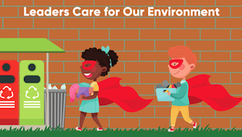
LAUNCH Project Toolkits
GRADESOFGREEN.ORG
Leaders Care For Our Environment!
There are many ways to be a leader and inspire others toward environmental action. One person who has made it her life mission to motivate the world is student activist, Greta Thunberg. She has given several speeches at environmental conferences and even spoken at the United Nations as a part of her goal to convince world leaders to take stronger action on climate change. However, you don’t need to speak at the UN to create impactful change for the environment. You can inspire those around you with your actions and commitment. Creating a Green Team is just one way you can encourage others to become environmentalists and be a leader in your own community.

Slide 4
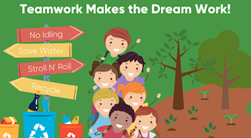
LAUNCH Project Toolkits
GRADESOFGREEN.ORG
Teamwork Makes the Dream Work!
Creating a Green Team is the best way to get more people involved with the environment. Collaboration is not just beneficial, but necessary to protect the planet on a global scale. By connecting your peers, Green Teams allow a community to form where ideas can be shared and discussed. Student led groups can be a powerful force for change. Remember, we are all in this together!

