Slide 1

LAUNCH Project Toolkits
Green Your Holidays

Slide 2
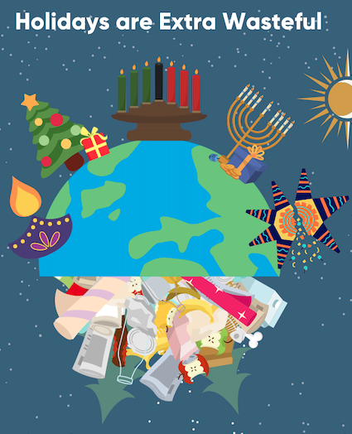

LAUNCH Project Toolkits
GRADESOFGREEN.ORG
Holidays are Extra Wasteful
After all the gift giving, seasonal decorations, delicious food, and family gatherings, our happy celebrations can leave a lot of preventable waste behind. From Thanksgiving to New Year's, the amount of trash we throw away increases by 25% compared to the rest of the year. This leads to an extra 1 million tons of garbage in our landfills every week or 25 million tons in total.

Slide 3
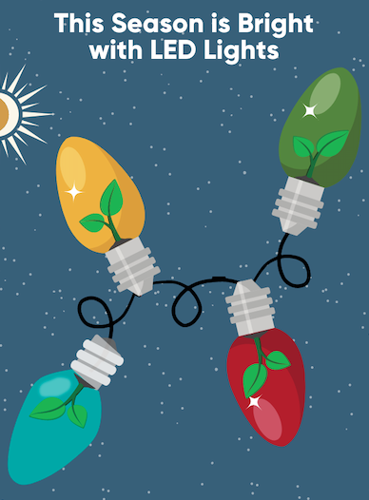
LAUNCH Project Toolkits
GRADESOFGREEN.ORG
This Season is Bright with LED Lights
Households that use LED lighting instead of their traditional holiday decorations, can save up to 90% of their energy use and these bulbs will last ten times longer. Your family and classroom could also save up to 30% of its energy use when plugging in lights or decorations into smart power strips.

Slide 4
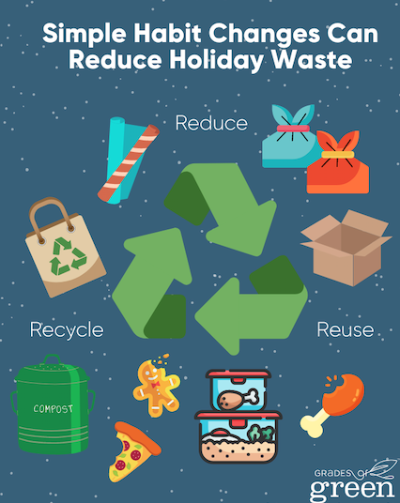
LAUNCH Project Toolkits
GRADESOFGREEN.ORG
Simple Habit Changes Can Reduce Holiday Waste
With the global increase in sustainability and eco-friendly packaging, we have the tools we need to limit our environmental impact this holiday season. Always remember the 3 Rs: Reduce, Reuse, and Recycle. For example, you can reduce food waste by creating new recipes with leftover food, recycling wrapping paper and cardboard boxes, and reusing your items next year. According to Stanford University, wrapping just three presents with reusable materials can save enough paper to fill 45,000 football fields.

