Slide 1

LAUNCH Project Toolkits
Less is More

Slide 2
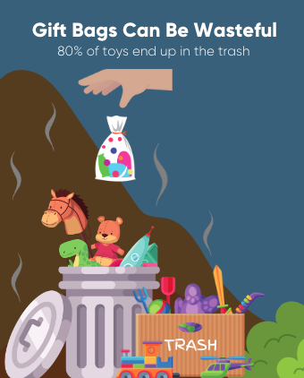

LAUNCH Project Toolkits
GRADESOFGREEN.ORG
Birthday Goody Bags Can be Wasteful
After many birthday celebrations, goody bags are given out. While all these little toys and candy may seem amazing at first sight, they are typically thrown out or break apart after just minutes of use. Approximately 80% of toys are tossed in the trash and since they are non-biodegradable, they don’t get recycled and end up in landfills. Remember, the 3 R’s (in order) are very important to help reduce this issue: reduce, reuse, and recycle.

Slide 3
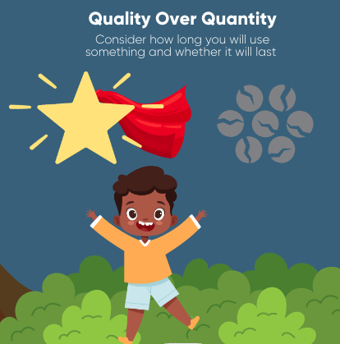
LAUNCH Project Toolkits
GRADESOFGREEN.ORG
Quality over Quantity
As our world keeps advancing with new, bigger, and “better” things, it’s hard not to want to keep up with all the latest toys and clothing trends you may spot around your community. Before you decide to get something, ask yourself this mindful question: Will I really use this item and if I do, how long will it last for? Hopefully, this can help guide you on what is a need and what is just a “want” that might break apart in a couple of days. Studies show that, in America, around 85% of all textiles (clothing materials) are thrown out. This shows us much of the stuff we collect is wasted and at the end of the day, they end up in landfills. When you find yourself deciding on an item, think about will you really use it or is it just something to add to your growing collection of things? Having quality experiences with friends and family such as going for a neighborhood walk, hike, or bike ride can reduce the want for more stuff while also improving health and saving money.

Slide 4
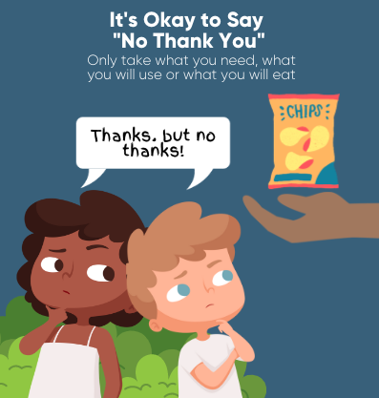
LAUNCH Project Toolkits
GRADESOFGREEN.ORG
It’s Okay to Say “No Thank You”
Sometimes it can be challenging to resist tempting prizes at fairs or say no to food put on our plate in the cafeteria, but both of these things contribute largely to overconsumption. In America, nearly 40% of all food is wasted. Here’s how we can help: politely saying “no thank you” when asked to take food that we know we will not eat or prizes that we see no use for is OKAY! While it seems hard at first, normalizing this will better our environment by reducing overconsumption and lessening waste produced by excessive food or plastic intake.

