Slide 1

LAUNCH Project Toolkits
Lunchtime Sorting

Slide 2
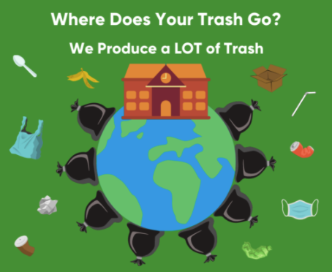

LAUNCH Project Toolkits
GRADESOFGREEN.ORG
We Produce A LOT of Trash!
Reducing the amount of trash in landfills is important because it reduces the amount of resources used by processing facilities. According to the EPA, the average American student creates 67 pounds of lunch packaging waste each school year. That’s more than 18,000 pounds of plastic, paper, and other non-food materials for just one average-sized elementary school.

Slide 3
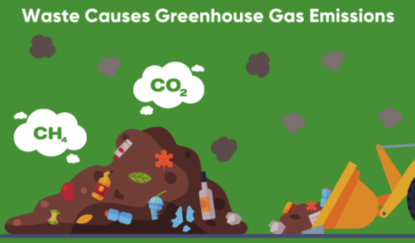
LAUNCH Project Toolkits
GRADESOFGREEN.ORG
Waste Causes Greenhouse Gas Emissions!
Fossil fuels are used for a majority of production and waste sectors across the world. This means that fossil fuels are used both to produce our packaging and dispose of it after it has been discarded. All of these fossil fuels give off greenhouse gasses that warm our planet and lead to climate change. In 2019, landfills alone produced 91 million metric tons of CO2 in the United States. That’s the same weight as 455,000 blue whales!

Slide 4
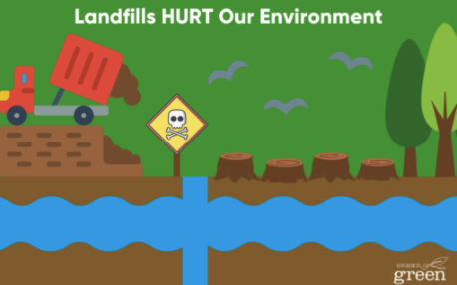
LAUNCH Project Toolkits
GRADESOFGREEN.ORG
Landfills HURT Our Environment
The formation of landfills has numerous negative impacts on our environment. In addition to greenhouse gas emissions, landfills contaminate groundwater, cause deforestation, creates air pollution, and reduces soil fertility. Furthermore, biodiversity often decreases with 30-300 species being displaced for every hectare used for landfills.

