Slide 1

LAUNCH Project Toolkits
Meatless Monday

Slide 2


LAUNCH Project Toolkits
GRADESOFGREEN.ORG
Meat Uses a Lot of Water
Producing meat uses a lot of our earth’s limited natural resources that we count on for survival. For instance, it requires large amounts of water to grow the food that is fed to livestock in addition to the water supply needed to raise the livestock. A 1/4 pound burger uses the same amount of water that could be used to supply 1,700 people for a day (425 gallons)!

Slide 3
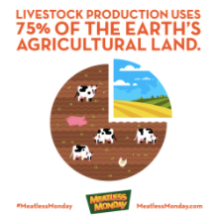
LAUNCH Project Toolkits
GRADESOFGREEN.ORG
Meat Uses a Lot of Land
Producing meat is very land intensive with millions of acres of forests being cleared every year for cattle production. Seventy-five percent of Earth’s agricultural land is used for livestock production.

Slide 4

LAUNCH Project Toolkits
GRADESOFGREEN.ORG
Meat Emits Greenhouse Gases
On top of all of this, greenhouse gasses are emitted during every phase of meat production contributing to global warming and the climate crisis. According to UN FAO (Food and Agricultural Organization of the United Nations), global livestock production creates 14.5% of global greenhouse gas emissions. Eating one less serving of beef each Monday for a year saves the same amount of CO2 emissions released when driving 348 miles in a vehicle.

