Slide 1

LAUNCH Project Toolkits
No Idle Zone

Slide 2
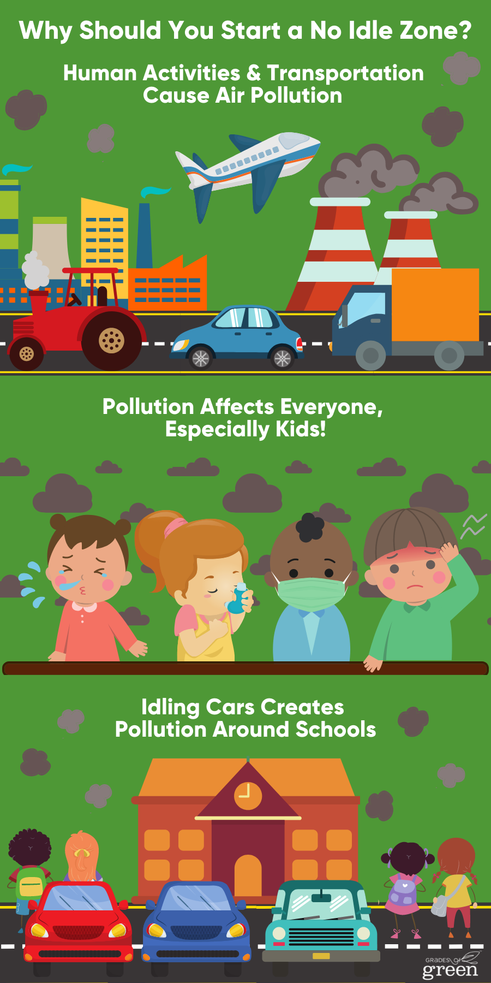

LAUNCH Project Toolkits
GRADESOFGREEN.ORG
Human Activities Cause Air Pollution
Every day human activities such as driving and manufacturing add greenhouse gasses and particulates to our air.
These gasses and particulates cause air pollution which can be bad for the environment and our health.
Additionally, these harmful gasses absorb heat from the sun and add to the already increasing temperature of the earth’s atmosphere.

Slide 3
LAUNCH Project Toolkits
GRADESOFGREEN.ORG
Transportation creates pollution
The EPA has identified 188 Hazardous Air Pollutants also known as Air Toxics.
Many of these come from cars and trucks that are on our roads every day.
Pollution emitted from cars and trucks are called Mobile Source Air Toxics and are the largest contributor to air pollution in the US (US EPA).

Slide 4
LAUNCH Project Toolkits
GRADESOFGREEN.ORG
Pollution affects everyone, especially kids!
Toxins from cars and trucks have proven to cause serious health effects such as asthma and cancer.
Children are even more at risk when surrounded by these toxins because their lungs are still developing.
It is proven that when children are exposed to high levels of toxic air they are more likely to develop asthma, respiratory problems and other health complications. (US EPA)

Slide 5
Idling cars create pollution around schools
Studies at school’s have shown that many parents tend to idle their vehicles when waiting to pick up their students and there are elevated levels of air toxics during these afternoon pickup times.
While children’s lungs are especially susceptible to air pollution, limiting idling can dramatically reduce these pollutants and children’s exposure to them (US EPA).

