Slide 1
LAUNCH Project Toolkits Plan an Edible Garden

Slide 2
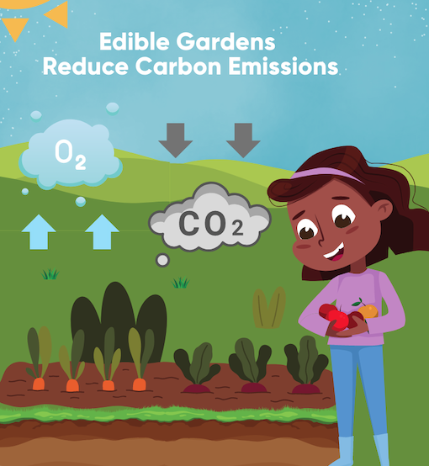
LAUNCH Project Toolkits
GRADESOFGREEN.ORG
Edible Gardens Reduce Carbon Emissions
Growing food in a school, home, or community garden reduces carbon emissions. Transporting fruits and vegetables from a farm to our markets means trucks, planes, and ships are producing carbon emissions, which are harmful to our planet. In fact, food transportation creates one fifth of the total emissions of the food industry. Also, fresh-picked food from a garden doesn’t need plastic packaging!

Slide 3
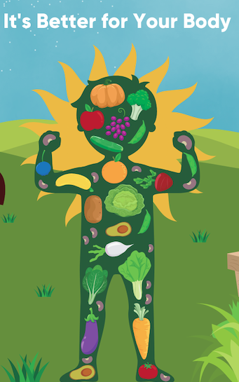
LAUNCH Project Toolkits
GRADESOFGREEN.ORG
It’s Better for Your Body
Garden-grown food is better for our health. Because we pick our fruits and vegetables later on in the growth cycle, there’s more nutrients in garden produce than large-scale agriculture produce. Plus, you save money!

Slide 4
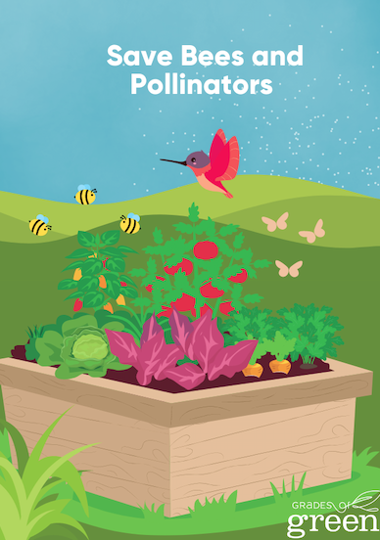
LAUNCH Project Toolkits
GRADESOFGREEN.ORG
Save Bees and Other Pollinators
Growing your own food without pesticides, including herbicides, supports local ecosystems. According to The Bee Conservancy, harmful pesticides are a leading cause of pollinator declines. (https://thebeeconservancy.org/why-bees/) By growing fruits and vegetables, you can provide a safe haven for pollinators (who are really important for the earth’s ecosystems!).

