Slide 1

LAUNCH Project Toolkits
ReTHINK Waste Game

Slide 2
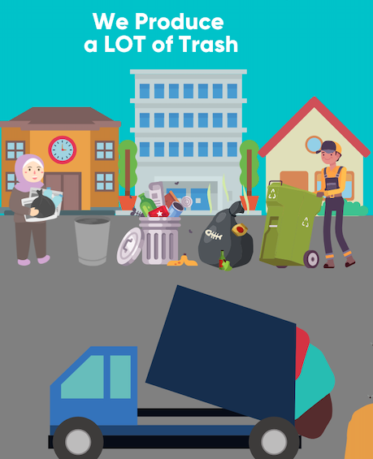

LAUNCH Project Toolkits
GRADESOFGREEN.ORG
Our landfills are filling up at an alarming rate, often with resources that can be reused, composted, donated, recycled, or not even used in the first place. We are running out of space in our landfills, which stresses the importance of reducing the amount of waste we produce.

Slide 3
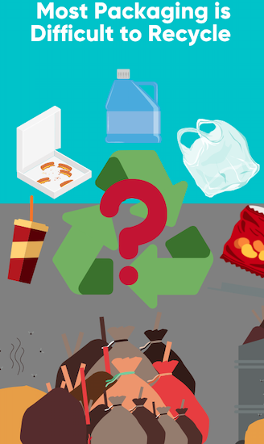
LAUNCH Project Toolkits
GRADESOFGREEN.ORG
Most packaging is difficult to recycle because it is made with hard to recycle materials like plastics or is contaminated with leftover food. Of the 14.5 million tons of container and packaging plastics produced in the US yearly, less than 9% of it is actually recycled. Even when we put plastic in the recycle bin, most of it will still end up in a landfill. This plastic packaging is made from oil, a natural resource that requires energy to produce and release greenhouse gasses that cause climate change throughout its lifecycle.

Slide 4
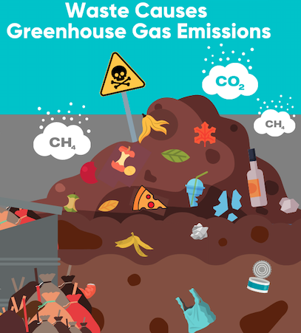
LAUNCH Project Toolkits
GRADESOFGREEN.ORG
While there are many short Everything we buy and throw away including clothing, electronics, single-use plastics, and food has a large environmental cost. The manufacturing, distribution, and use of the goods and food we rely on most - as well as management of the resulting waste - all require energy, which mostly comes from fossil fuels. [3]

