Slide 1

LAUNCH Project Toolkits
Stroll N’ Roll TOOLKIT

Slide 2
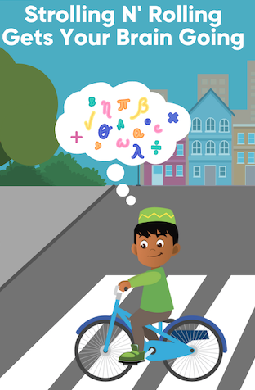

LAUNCH Project Toolkits
GRADESOFGREEN.ORG
Strolling N’ Rolling Gets the Brain Going
Spending time outside has numerous physical and mental benefits! Walking/biking/skating/scootering to school helps you get exercise and , being outside can increase classroom performance compared to those who commute in a car.

Slide 3
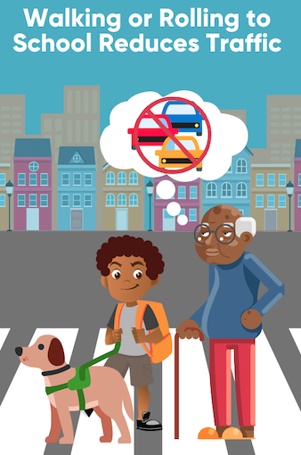
LAUNCH Project Toolkits
GRADESOFGREEN.ORG
Walking/Rolling to School Reduces Traffic
On top of the personal benefits of walking/biking to school, taking this action also helps the people around you. Roughly 10-14% of cars in the morning are students/student’s parents making their way to campus. In the United States alone, that is roughly 14 million cars everyday!

Slide 4
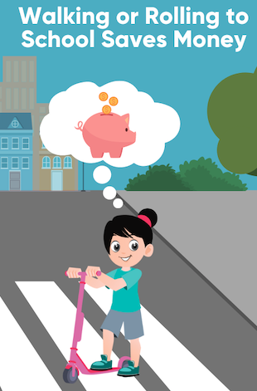
LAUNCH Project Toolkits
GRADESOFGREEN.ORG
Walking/Rolling to School Saves Money
We’ve learned a lot about the people who can benefit from students walking/rolling to school, but it is important to address how it can help families. Parents can save money by reducing their gasoline consumption while lowering carbon emissions that contribute to climate change. Furthermore, reducing the amount of cars on the road can decrease the amount of money spent on maintaining streets, while school districts can decrease the cost of bus systems. Some schools have even saved up to $237,000 as a result of students walking/biking to school.

