Slide 1

LAUNCH Project Toolkits
Trash Free Lunch

Slide 2
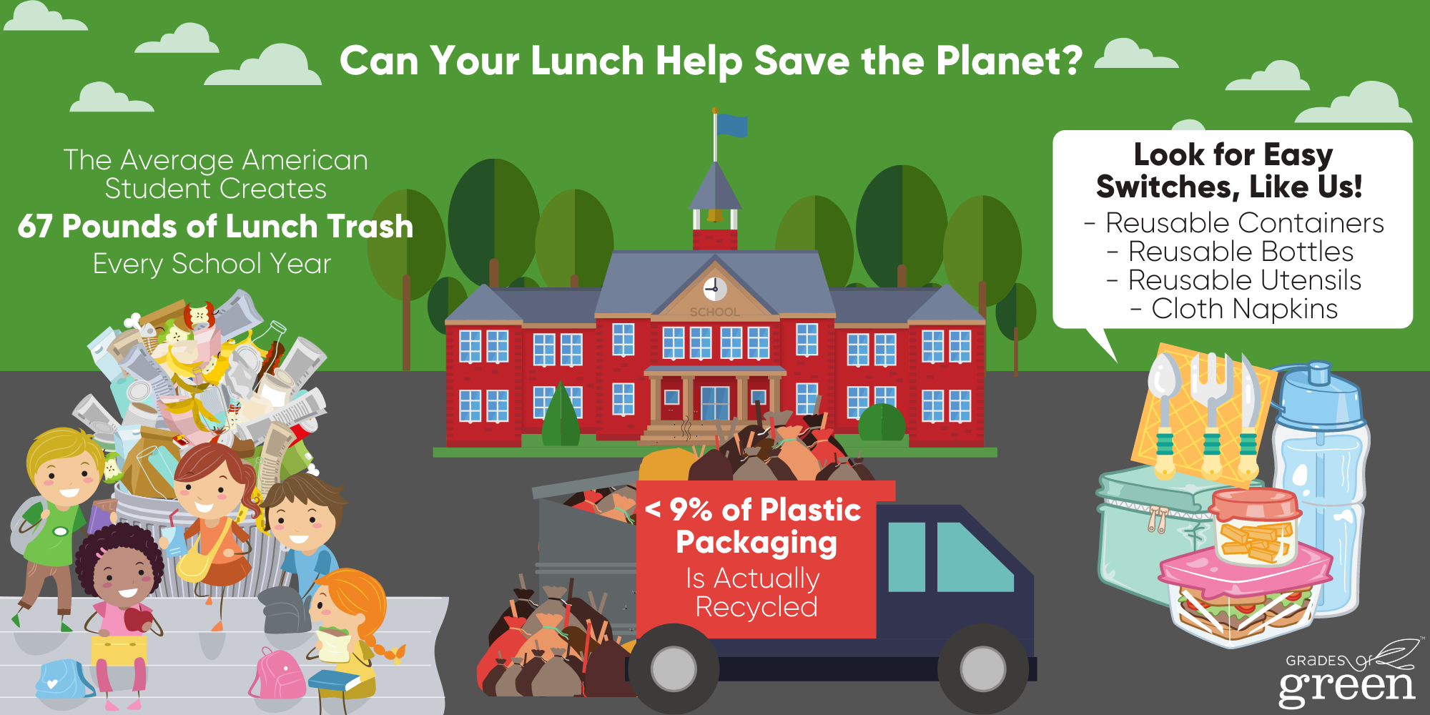

LAUNCH Project Toolkits
GRADESOFGREEN.ORG
Lunches Create a Lot of Waste
Whether you’re packing a full lunch for school, bringing a snack for recess or packing food to go somewhere on the weekends, choosing to pack Trash Free reduces waste, saves natural resources and saves money!
According to the EPA, the average American student creates 67 pounds of lunch packaging waste each school year.
That’s more than 18,000 pounds of plastic, paper, and other non-food materials for just one average-sized elementary school (EcoCycle).

Slide 3
LAUNCH Project Toolkits
GRADESOFGREEN.ORG
Plastic Waste is Hard to Recycle
Most packaging is difficult to recycle because it is made with hard to recycle materials like plastics or is contaminated with leftover food.
Of the 14.5 million tons of container and packaging plastics produced in the US yearly (EPA), less than 9% of it is actually recycled. Even when we put plastic in the recycle bin, most of it will still end up in a landfill.
This plastic packaging is made from oil, a natural resource that requires energy to produce and releases greenhouse gasses that cause climate change throughout its lifecycle

Slide 4
LAUNCH Project Toolkits
GRADESOFGREEN.ORG
Choose to Go Trash-Free!
By making simple changes like:
Packing food and drinks in reusable containers
Bringing reusable utensils/cloth napkins
You can reduce your waste and make your school and community more sustainable!

