Slide 1

LAUNCH Project Toolkits
Clothing Swap

Slide 2
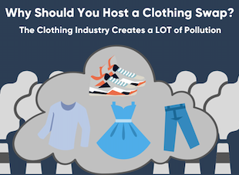

LAUNCH Project Toolkits
GRADESOFGREEN.ORG
Clothes Pollute!
The fashion industry has a major role in global carbon emissions per year. Over the course of a year, the fashion industry is responsible for 10% of annual global carbon emissions. That is more greenhouse gasses than flights and maritime shipping combined!

Slide 3
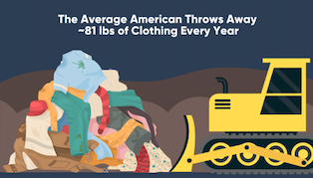
LAUNCH Project Toolkits
GRADESOFGREEN.ORG
Clothes Go to Landfills!
Every year, the average American throws away roughly 81 pounds of clothing. Less than 1% of this clothing is recycled into new garments which causes a majority of textile waste to enter our landfills.

Slide 4
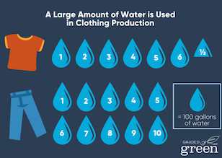
LAUNCH Project Toolkits
GRADESOFGREEN.ORG
Clothes Use Water!
In addition to creating greenhouse gasses, the production of clothing uses a large amount of water. To make a single pair of jeans, it takes 3,781 liters (999 gallons) of water and 2,460 liters (650 gallons) of water to make a single shirt.

