Slide 1
LAUNCH Project Toolkits
Harvest and Sustain Your Garden

Slide 2
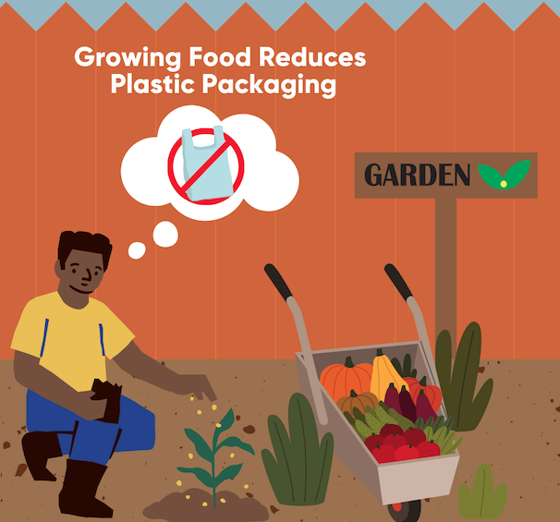
LAUNCH Project Toolkits
GRADESOFGREEN.ORG
Growing Food Reduces Plastic Packaging
Single-use plastics, widely used in food packaging, present a pressing environmental and health issue. These plastics, primarily derived from fossil fuel-based chemicals, contribute to carbon emissions and climate change. Shockingly, a staggering 150 million tons of single-use plastics are produced annually worldwide, with the majority ending up in landfills or polluting our environment. As they degrade, they break down into microplastics, persisting in ecosystems and posing threats to wildlife and human health. Exposure to the chemicals in plastics can disrupt hormones, cause fertility problems, and increase the risk of cancer. To combat this crisis, it is vital to reduce our reliance on single-use plastics, opting for sustainable alternatives, embracing reusable options and by growing our own food to reduce the amount of packaged produce that we purchase. By making conscious choices and adopting eco-friendly practices, we can minimize plastic waste, protect the planet, and safeguard our well-being for a sustainable future.

Slide 3
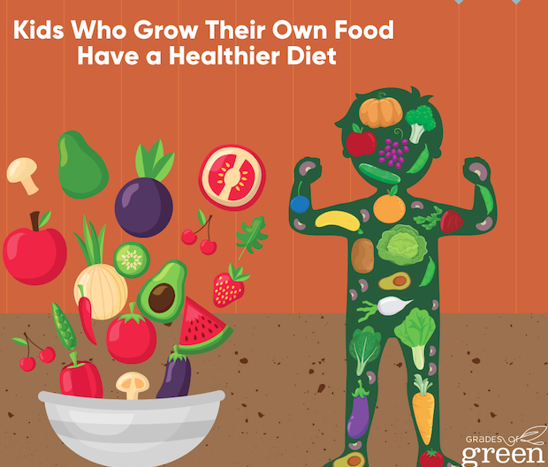
LAUNCH Project Toolkits
GRADESOFGREEN.ORG
Kids Who Grow Their Own Food Have a Healthier Diet
When young people have the opportunity to learn about the origins of their food and gain hands-on experience in growing and preparing it, remarkable shifts in their eating habits can occur. Studies have shown that kids who participate in garden programs tend to consume an additional half serving of vegetables per day compared to their previous habits. This increase in fruit and vegetable consumption is a powerful catalyst for promoting healthy eating patterns, which in turn can significantly reduce the risk of developing chronic conditions such as cardiovascular disease, type 2 diabetes, and certain types of cancer. By empowering youth to make nutritious choices and fostering a deeper connection to their food, we can sow the seeds of lifelong health and well-being.

