Slide 1
LAUNCH Project Toolkits Maintain an Edible Garden

Slide 2
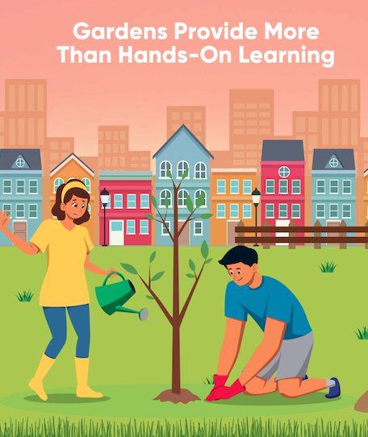
LAUNCH Project Toolkits
GRADESOFGREEN.ORG
Gardens Provide More Than Hands on Learning
Plants are incredible and play a vital role in sustaining life on Earth. They’re like the talented magicians of the natural world, performing an awe-inspiring trick that benefits us all. Although carbon dioxide may have a reputation for warming up our planet, plants have this fantastic ability to turn it into something valuable through a process called photosynthesis. With the help of sunlight and water, they work their botanical magic, transforming carbon dioxide into energy and releasing precious oxygen back into the atmosphere. It’s a remarkable dance of gasses that keeps our air clean and breathable. We owe a huge debt of gratitude to these green wonders because without them, we simply wouldn’t be able to survive. So let's give a big shout out to the power of plants and the remarkable job they do in producing oxygen for us to breathe and providing us with the delicious food that sustains us. It’s time to appreciate and protect our leafy friends for their crucial role in keeping our planet thriving.

Slide 3
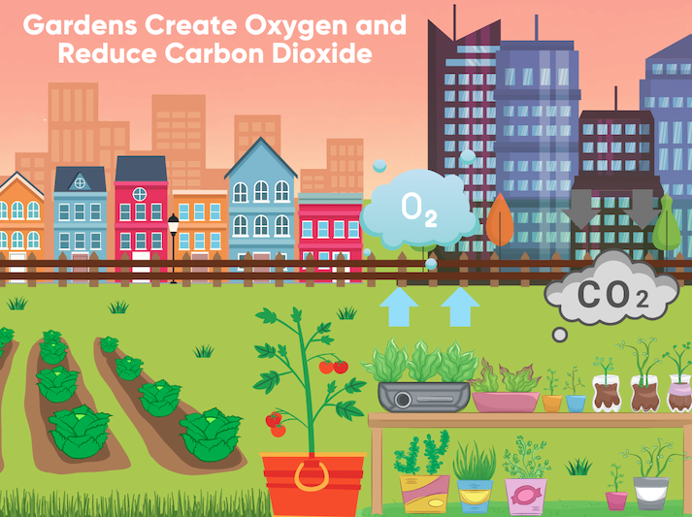
LAUNCH Project Toolkits
GRADESOFGREEN.ORG
Gardens Create Oxygen and Reduce Carbon Dioxide
Having a garden allows people to love and connect with nature. According to the National Center on Safe Supportive Learning Environments, gardening has been proven to help the body reduce levels of cortisol, a hormone released in stressful situations. As a result, gardening is great for managing anger, anxiety, and other negative emotions. Given the physiological benefits of gardening, it is unsurprising to find that in
dividuals of all ages who garden report feeling “relaxed” and “calm” when gardening. For students, this feeling of comfort creates an environment conducive for building self-confidence, working with others, and cooperating during learning. Over the past decade, experimental research on the social and emotional benefits of gardening has been limited. However, related studies indicate that when students are able to build their emotional and social capacities, these skills enable students to increase their academic performance by improving their participation in the classroom.

