Slide 1
LAUNCH Project Toolkits Maintain an Edible Garden

Slide 2
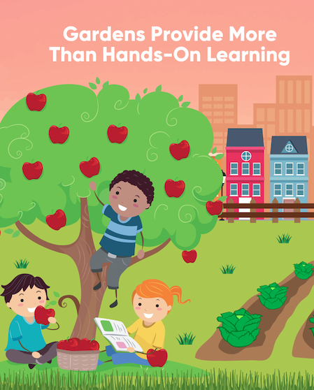
LAUNCH Project Toolkits
GRADESOFGREEN.ORG
Gardens Provide More Than Hands on Learning
Having a garden allows children to love and connect with nature. An edible garden is a garden where you can eat what you grow! Organic edible gardens are a more sustainable alternative to conventional gardening. They create healthy soil that removes CO2 from our atmosphere and eliminates dangerous chemicals and toxins that can occur in commercial produce. By using organic fertilizer in the soil and avoiding synthetic fertilizers, herbicides, and pesticides, the microorganisms in the soil that sequester carbon can continue to thrive. Synthetic nitrogen fertilizer can cause emissions of nitrous oxide, a greenhouse gas that is 300 times more potent than carbon dioxide. An organic garden has better soil quality, reducing fertilizer and pesticide run-off pollution.

Slide 3
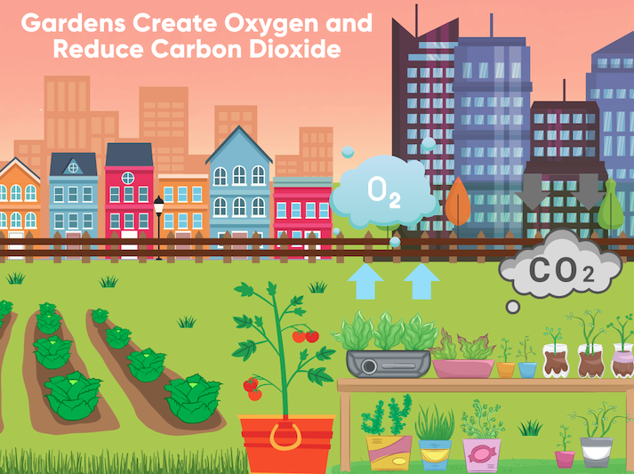
LAUNCH Project Toolkits
GRADESOFGREEN.ORG
Gardens Create Oxygen and Reduce Carbon Dioxide
Plants create oxygen for us to breathe and food for us to eat. Carbon dioxide is a gas that increases the warming of the planet but it is also used by plants in photosynthesis. These plants reduce the amount of carbon dioxide that ends up trapped in our atmosphere. The edible garden you have created uses Carbon Dioxide, along with sunlight and water to make energy and release oxygen. Plants can live without people but people cannot live without plants. Plants make the oxygen in the air that we breathe and are essential to life on Earth.

