Slide 1
LAUNCH Project Toolkits Plan an Edible Garden

Slide 2
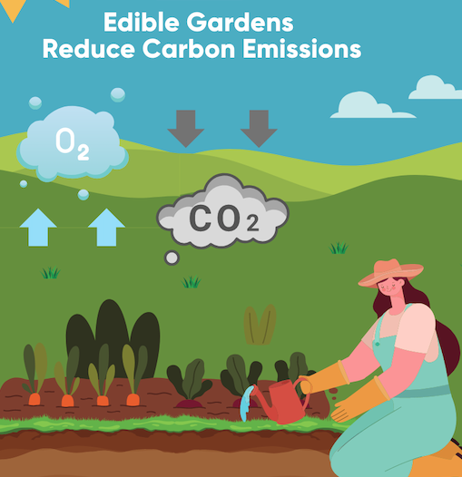
LAUNCH Project Toolkits
GRADESOFGREEN.ORG
Edible Gardens Reduce Carbon Emissions
Setting up gardens in schools, homes, or communities plays a vital role in reducing carbon emissions associated with food transportation. Transporting commercial fruits and vegetables from farms to markets creates harmful carbon emissions from trucks, planes, and ships. Surprisingly, the transportation of food alone is responsible for one-fifth of all emissions generated by the food industry. By growing our own food closer to where it is consumed, we can significantly decrease these emissions. School gardens, home gardens, and community gardens offer a sustainable alternative. When we cultivate our own produce, we eliminate the need for long-distance transportation. Instead, we can simply harvest fresh fruits and vegetables from our gardens, reducing the carbon footprint associated with food transport. So by growing food locally, we not only help combat climate change by reducing carbon emissions but also create a more sustainable and resilient future for ourselves and the planet we call home.

Slide 3
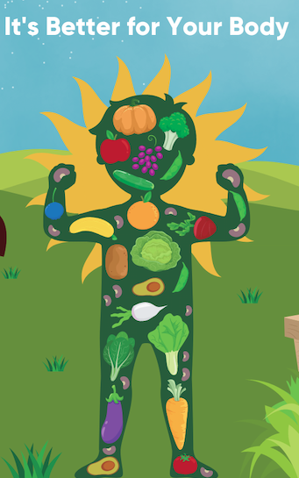
LAUNCH Project Toolkits
GRADESOFGREEN.ORG
It’s Better for Your Body
Growing your own food in a garden not only benefits the environment but also has significant advantages for our health. When we cultivate fruits and vegetables in our gardens, we have the opportunity to pick them at their peak ripeness, resulting in produce that is packed with nutrients. Compared to large-scale agricultural production, where crops are often harvested early for transportation purposes, garden-grown food tends to have higher nutritional value

Slide 4
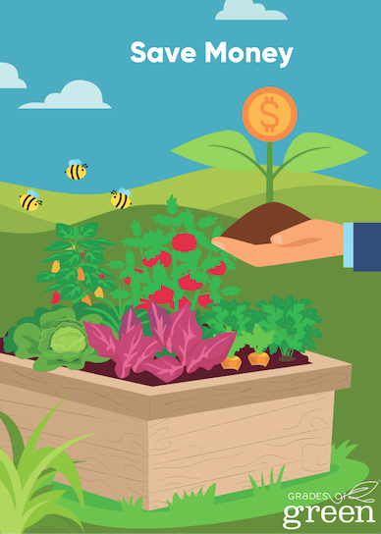
LAUNCH Project Toolkits
GRADESOFGREEN.ORG
Save Money
Additionally, growing your own food can lead to significant cost savings. By investing time and effort in a garden, you can produce a large amount of food at a fraction of the cost of purchasing the same quantity from the market. It reduces your grocery expenses and allows you to enjoy the satisfaction of eating food you have nurtured and grown yourself.
By growing your own organic food in a garden, you can enjoy the double benefit of accessing highly nutritious produce and saving money in the process. It’s a rewarding and healthy way to take charge of your diet and promote a sustainable lifestyle.

