Slide 1
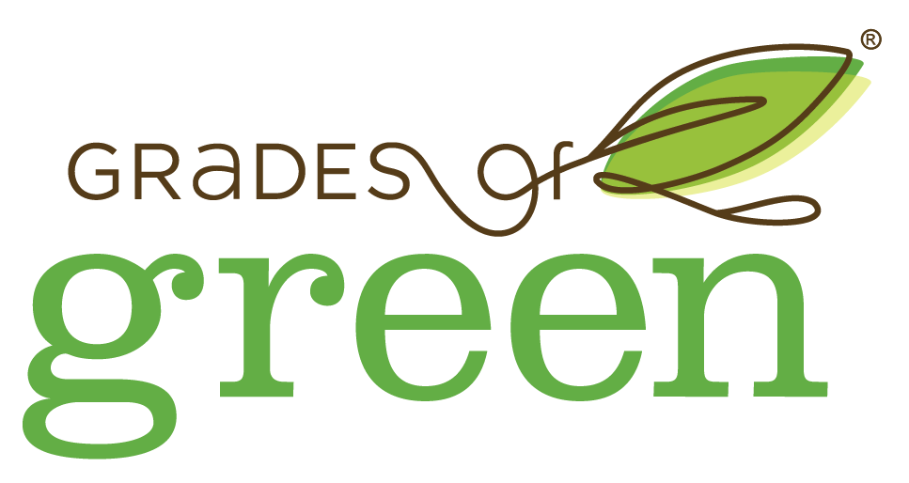
LAUNCH Project Toolkits Plant an Edible Garden

Slide 2
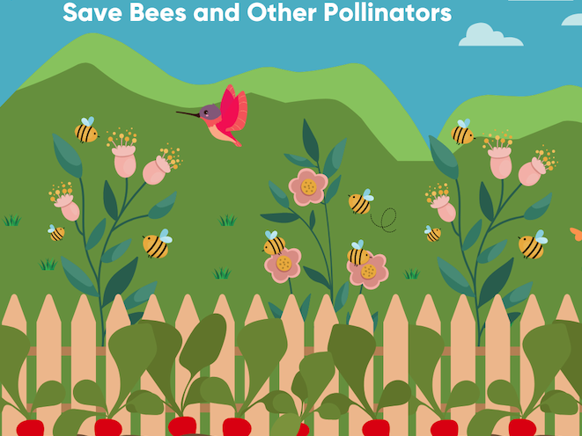
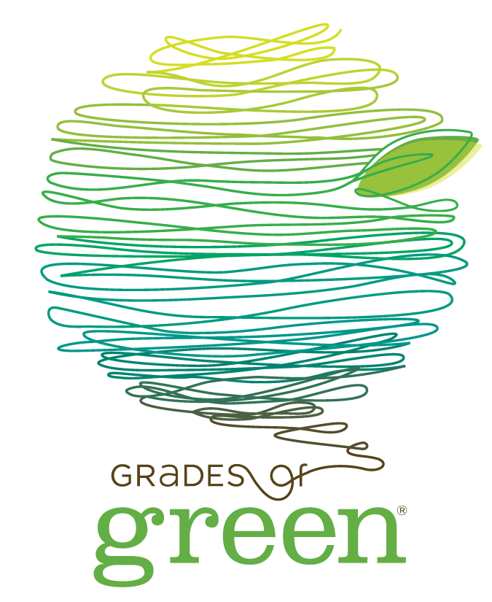
LAUNCH Project Toolkits
GRADESOFGREEN.ORG
Save Bees and Other Pollinators
Edible gardens are not just delicious and nutritious, they also play a vital role in supporting local ecosystems. Pollinators, like bees, butterflies and birds, are superheroes for our planet. They help plants reproduce by transferring pollen from one flower to another, allowing them to bear fruits and vegetables. Unfortunately, pollinators are facing challenges, and one of the main culprits is pesticides. These chemicals harm pollinators, leading to their decline. But fear not aspiring gardeners! By growing your own fruits and vegetables organically, you can create a safe haven for these incredible creatures. Your edible garden becomes a buzzing paradise, attracting bees and other pollinators to do their magical work. So let’s skip harmful pesticides, and become champions for our pollinator friends and the Earth’s ecosystems.

Slide 3
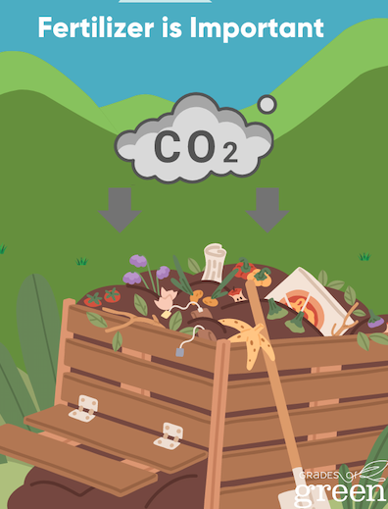
LAUNCH Project Toolkits
GRADESOFGREEN.ORG
Fertilizer is Important
By using organic fertilizer in the soil and avoiding synthetic fertilizers, herbicides, and pesticides, the microorganisms in the soil that sequester carbon can continue to thrive. Synthetic nitrogen fertilizer can cause nitrous oxide emissions, a greenhouse gas 300 times more potent than carbon dioxide. An organic garden has better soil quality, reducing fertilizer and pesticide run-off pollution.

