Slide 1

LAUNCH Project Toolkits
Community/Beach Clean Up

Slide 2
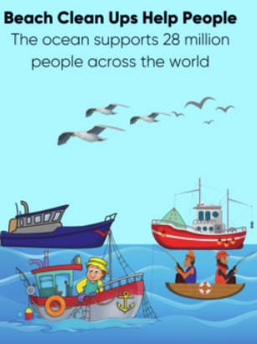

LAUNCH Project Toolkits
GRADESOFGREEN.ORG
Beach Clean Ups are Important!
As waste continues to grow across the world, reducing the amount of trash in the environment becomes an ever growing necessity. Oceans in particular require much needed attention due to the dangers imposed by excess waste on marine life. Coastal regions and supporting waters employ over 28 million people, which rely on a clean environment to operate. In addition, 85% of US tourist attractions are located along coastal regions, which highlights the importance of beach Clean Ups.

Slide 3
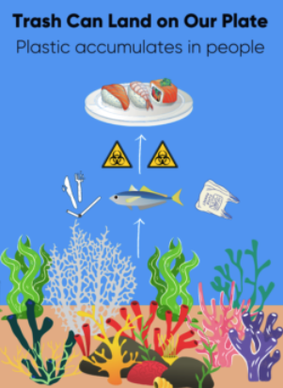
LAUNCH Project Toolkits
GRADESOFGREEN.ORG
Trash Can Land on Our Plate!
Without thoughtful waste processing, a significant amount of trash can enter the environment and disrupt food webs. As various levels of marine life consume human disposed trash, the concentration of plastics increases with increasing trophic levels. When we catch and consume these fish, we are also ingesting some of the items they consumed as well. According to a study in Belgium, it is estimated that the average seafood consumer eats 11,000 micro fragments of plastic annually, which can accumulate in our body and have varying health issues.

Slide 4
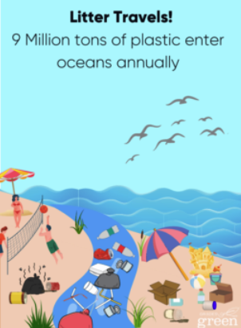
LAUNCH Project Toolkits
GRADESOFGREEN.ORG
Trash Travels!
A plastic wrapper dropped in the parking lot doesn’t stay there for long. It gets blown to the curb, washed through storm drains into rivers, and out to sea. Scientists estimate that almost 9 million tons of plastic litter end up in the ocean—every year. This is the equivalent of five grocery bags filled with plastic trash sitting on every foot of coastline around the world.

